Slide 1



Understanding remote work & Employee mental health challenges
A project to explore design interventions from the employee and employer perspectives
Project GROUP: Lisa Siefker, Jarrod Hay

Slide 2

BACKGROUND
Covid-19 forced many employees to shift to remote work
Disrupted longstanding norms around the daily commute, the cubicle, and the water cooler
For many, remote or hybrid work continued after pandemic subsided
Remote work presents both advantages and challenges for employees and employers
Difficult to balance multiple competing perspectives in remote work situations

Slide 3

Remote work benefits*
Increased flexibility
Reduced commute
Improved work-life balance
Increased productivity
Reduced overhead
Increased skill base
*Mann, Sandi & Holdsworth, Lynn. (2003). The Psychological Impact of Teleworking: Stress, Emotions and Health. New Technology, Work and Employment. 18. 196 - 211.10.1111/1468- 005X.00121.

Slide 4

Remote work Challenges*
Social isolation
Presenteeism (working long hours, working when sick)
Lack of support & connection
Blurring of boundaries
*Mann, Sandi & Holdsworth, Lynn. (2003). The Psychological Impact of Teleworking: Stress, Emotions and Health. New Technology, Work and Employment. 18. 196 - 211.10.1111/1468- 005X.00121.

Slide 5
Impact of remote work on mental health
Feelings of isolation can cause employees to disengage and may lead to anxiety or depression. The blurring of boundaries between work and personal space and time can lead to longer working hours and feelings of burnout*.
An employee who is struggling with anxiety, depression, or burnout is likely less engaged with work, leading to decreased productivity and a negative impact the business.
*Figueiredo E, Margaça C, Hernández-Sánchez B, Sánchez-García JC. Teleworking Effects on Mental Health—A Systematic Review and a Research Agenda. International Journal of Environmental Research and Public Health. 2024; 21(3):243. https://doi.org/10.3390/ijerph21030243

Slide 6
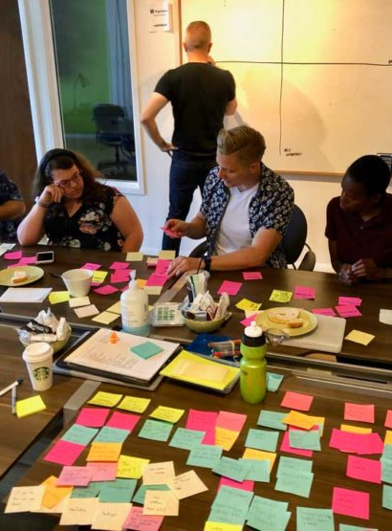
Project goal:
Gain insights from remote employees and employers to address remote and hybrid work challenges that lead to feelings of isolation, lack of support and burnout.
We aim to use these insights to facilitate conversation and creative problem solving through workshops where employers and employees can collaborate, share perspectives, learn from eachother, and generate solutions.

Slide 7

research Questions:
How does remote and hybrid work contribute to feelings of isolation and burnout?
What strategies and solutions can be implemented to decrease feelings of isolation and burnout?
Can you maintain the benefits of remote work while also addressing the challenges that negatively impact mental health?

Slide 8
Research method
Remote Employee Survey
Remote Employee Diary Log
Remote Employee Workshop
Remote Employee/
Employer Workshop
Follow up Survey
Implement Workshop Solution(s)
Remote Employer Survey
Remote Employer Diary Log
Remote Employer Workshop

Slide 9

Participant Population
We plan to recruit both U.S. employers and employees working for organizations that are entirely remote or hybrid.
Identify issues from the top-down AND bottom-up to find solutions in the middle.

Slide 10

Recruitment Methods
Participants will be recruited via multiple methods that specifically target remote workers, including:
Local Coffee Shop Bulletin Boards
Co-Working Spaces (Co-Hatch, Kollektiv, etc.)
Social Media Posts/Advertising
Word of Mouth (employers providing survey to other employees)

Slide 11
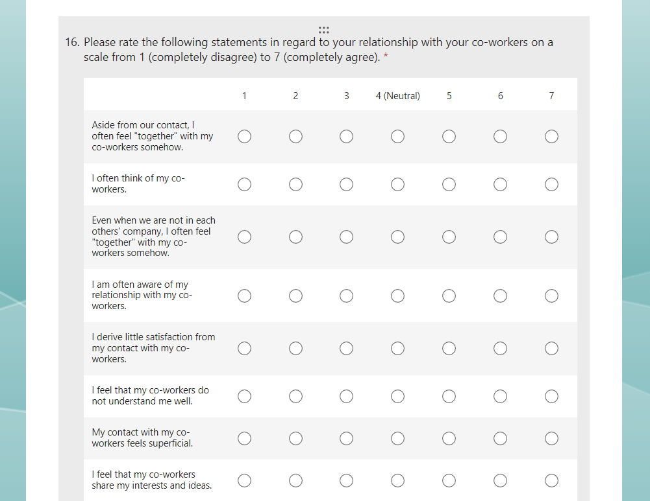
Initial Survey
Participants will all complete a virtual survey to understand more about their:
Interactions with co-workers*
Feelings of isolation*
Overall job satisfaction
*Rogers, K. The effects of remote work on organizational culture: Examining the effects of external social support to mitigate social isolation within organizations. Master's Thesis, University of Tennessee, 2022. https://trace.tennessee.edu/utk_gradthes/6473

Slide 12
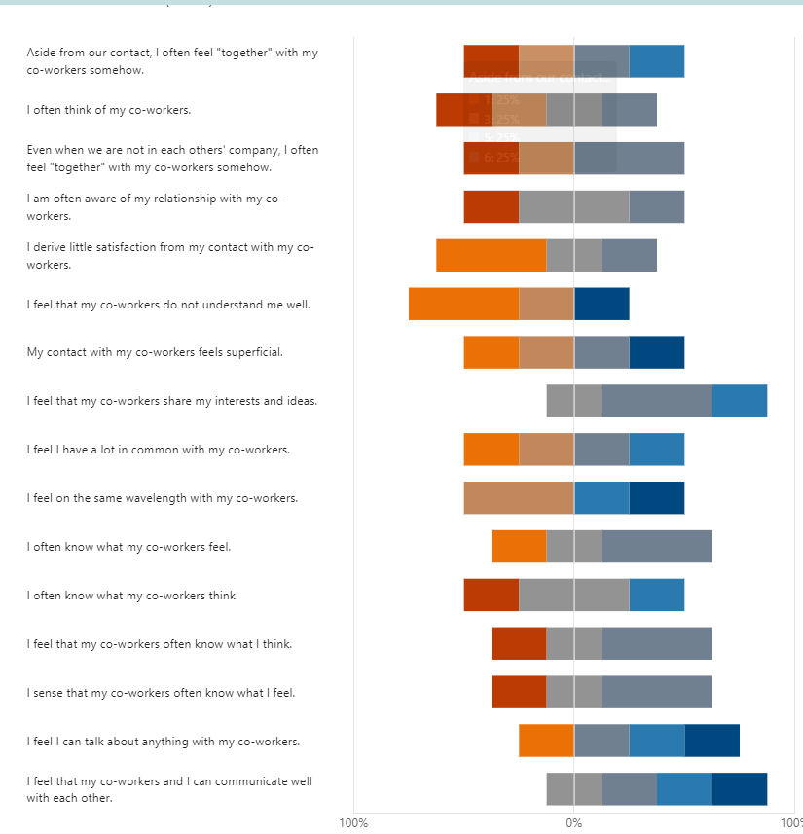
User testing
Results showed wide variation on metrics of perceived isolation and job satisfaction.
Test participants provided feedback that the survey was concise and covered a lot of different areas.
Additionally, feedback indicated that the Likert scales formatted strangely on a mobile device, so future iterations would recommend completing the survey on a laptop/desktop computer.

Slide 13

Employer & employee Diary logs
Participants are selected based on survey responses and placed in 1) employer group or 2) employee group
Receive diary log instructions
Complete diary log for one week to document:
- remote/hybrid work schedules; - scheduled interactions with supervisors, colleagues, or other people - serendipitous/unplanned interactions with supervisors, colleagues, or other people; - feelings of isolation, lack of support, or burnout

Slide 14

Employer & employee workshops
Employer and employee groups will first meet separately:
Opportunities for individual participant interviews
Small and large group guided discussions
Record qualitative data, themes and attitudes
Broad, divergent approach
Document all themes and ideas for future analysis

Slide 15

combined Employer & employee workshop
Bring employer and employee groups together to:
Guided discussion of themes and ideas from individual workshops
Opportunities for individual discussion and connection
Participants have opportunity to build awareness and empathy for individuals in the other group
Collaborate and identify potential solutions or opportunities for experimentation

Slide 16
implementation
Employee and employer participants will implement potential solutions identified at the workshops
Participants will be asked to complete a weekly log to document:
- implementation details
- remote/hybrid work schedules - planned and unplanned interactions with supervisors, colleagues, or other people
- feelings of isolation, lack of support, or burnout

Slide 17

Follow up survey
3 months following implementation of the solutions, employers and employee groups will complete a follow up survey
Collect data on success of solutions (decreased feelings of isolation and burnout, increased employee engagement)
Compare data to initial survey results
Recognize opportunities for improvement or revision
Identify any new or secondary problems

Slide 18
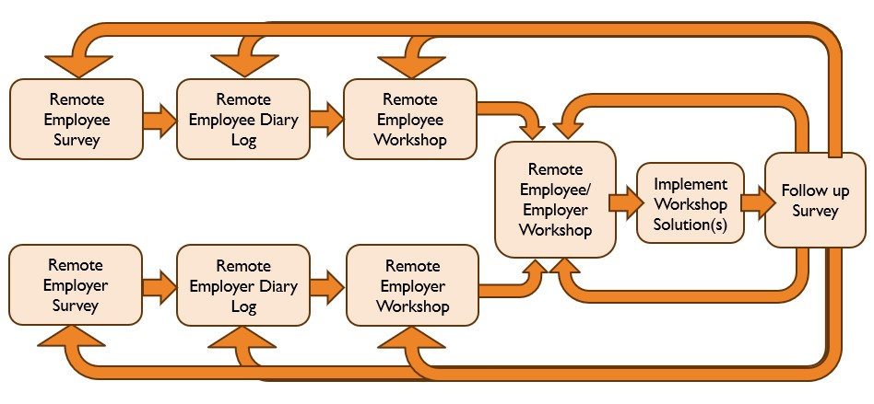
Iterate & Improve Upon solution
Analyze employee and employer logs and survey data to determine next steps in process:
Continue with solution
Implement alternative solution
Collect additional data via workshops, surveys or interviews

Slide 19

Activation strategy:
Research participants could implement potential solutions identified at the collaborative employer-employee workshop. After a solution is implemented, a follow-up survey should be circulated to collect feedback on whether:
the solution decreased employee feelings of isolation or burnout,
the solution increased feelings of support and connection,
the solution could be improved upon,
alternative solutions should be explored.
This iterative feedback strategy can be repeated until both employees and employers are satisfied with the solution. This approach allows freedom to experiment and make changes to the solution. By continuously collecting feedback, this approach ensures that the solution remains focused on the problem and the people involved.

Slide 20
Key learnings
A Design Thinking approach is flexible and can be adjusted throughout the process depending on the outcome
A human-centered approach to data is key: exercise empathy and get to know the people who know the problem
Innovate – allow for experimentation, exploration, and iteration. Gather data along the way to support decisions

